Slide 1

Cps 109 Lab 6
Gurpreet Kaur

Slide 2
Agenda
Recursion
01
Mutability
02
Quiz
03

Slide 3
Recursion
Lets Discuss about Functions
What you know about functions??/

Slide 4
Have your heard about Recursion ?
Are you scared??

Slide 5
Recursion
Recursion is the process of defining something in terms of itself
A physical world example would be to place 2 parallel mirrors facing each other . Any object in between them would be reflected recursively

Slide 6
Python Recursive function
In Python , we know that a function can call other functions . It is even possible for the functions to call itself . These type of constructs are termed as recursive functions

Slide 7
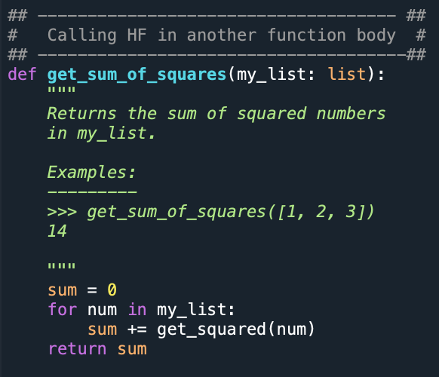
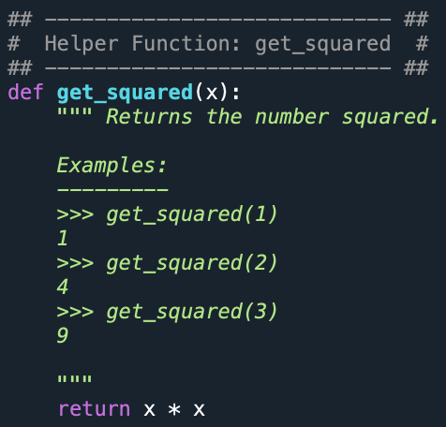

Example

Slide 8
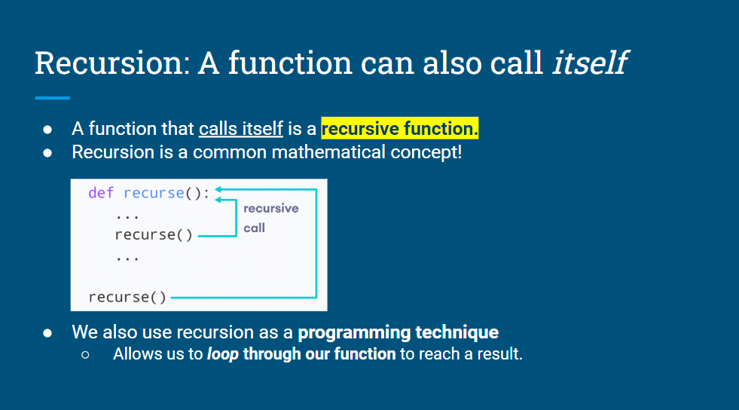

Slide 9
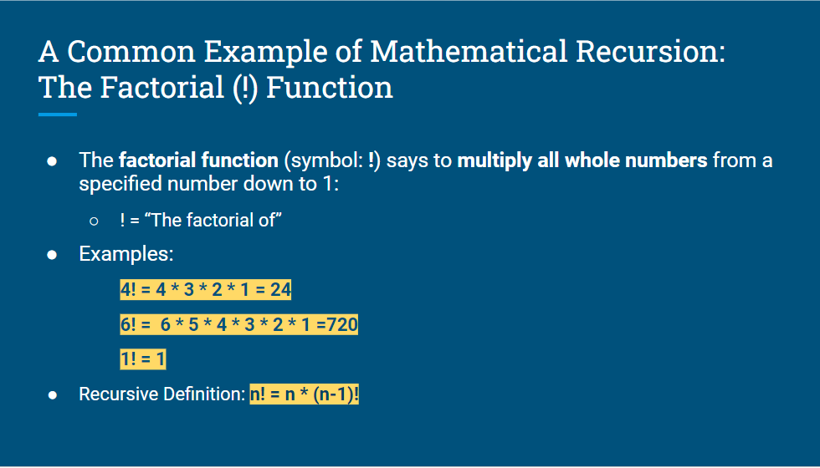

Slide 10
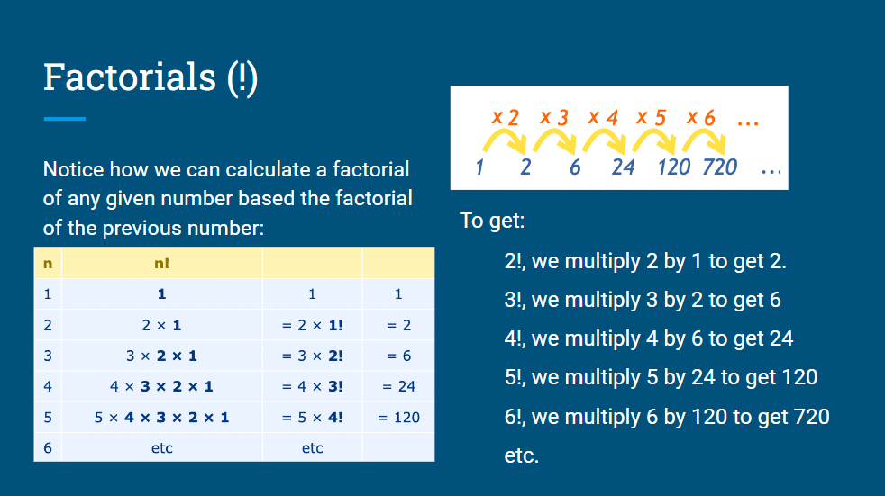

Slide 11
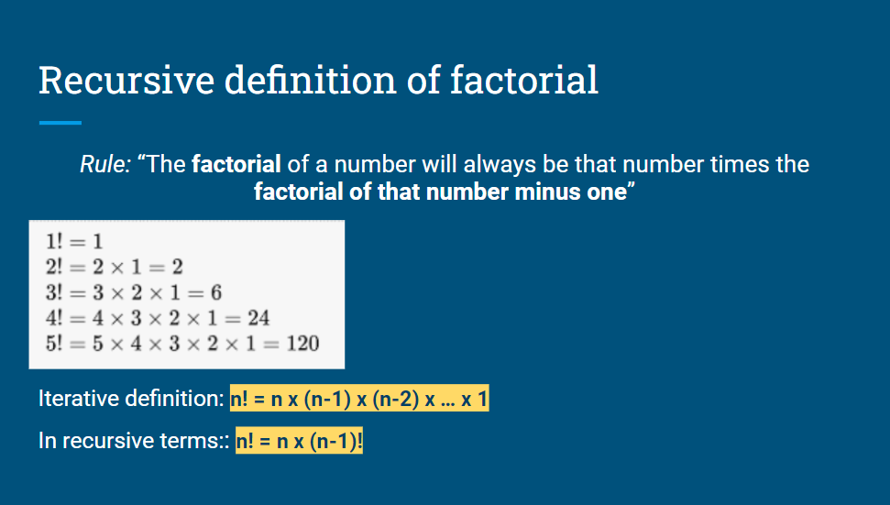

Slide 12
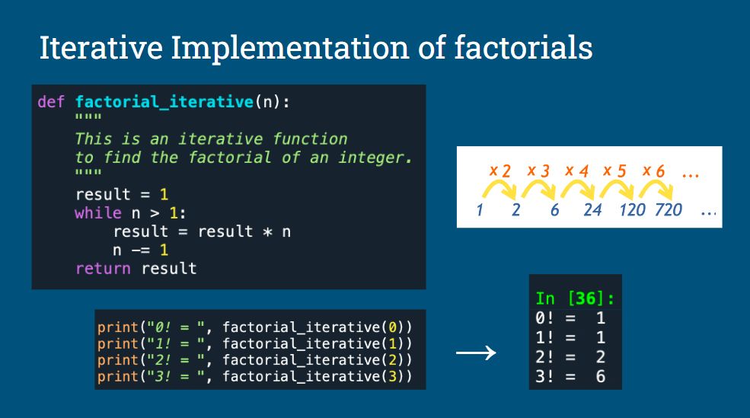

Slide 13
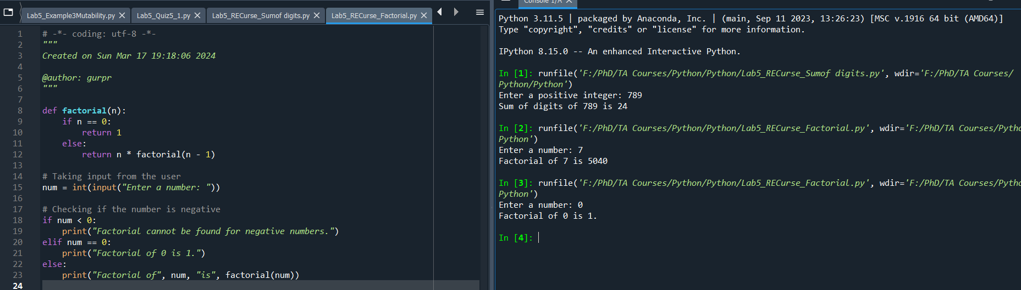
Example : Factorial

Slide 14
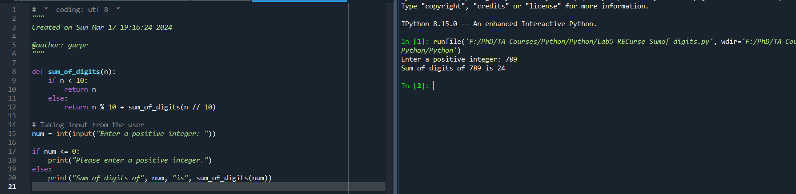
Example : SumofDigits.py

Slide 15
Mutability
You might have heard us saying that lists are “mutable”, and strings are “immutable”
Can you tell what does that mean?

Slide 16
Mutability
Something is mutable if its contents can be changed (like a list).
Something is immutable if its contents cannot be changed (like a string or a tuple)

Slide 17
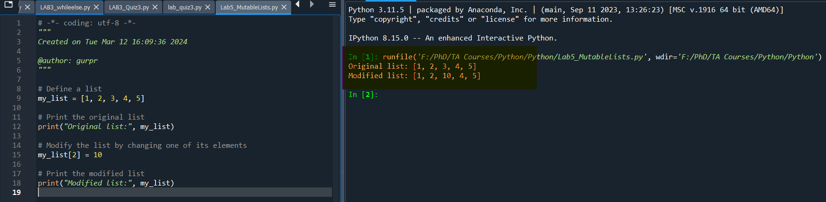
Example :: Lab5_MutableLists.py

Slide 18
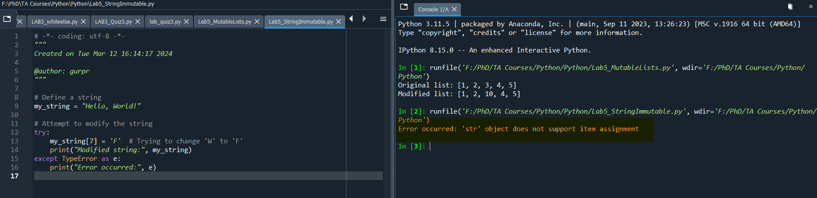
Example : Lab5_StringsImmutable.py

Slide 19
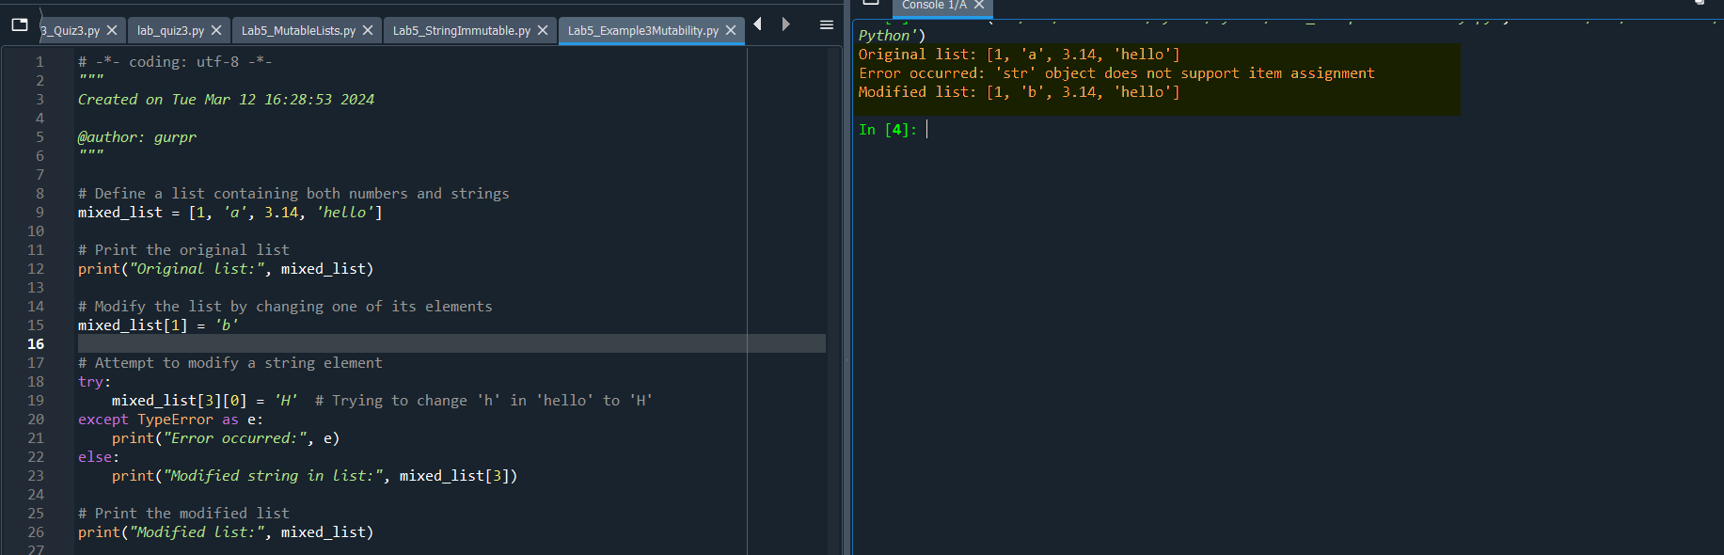
Combined Example : Example3Mutability.py

Slide 20
Thanks!!
Any Questions !!

Slide 21
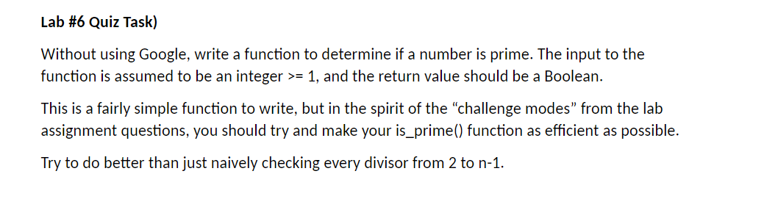
Quiz Time !!

